Slide 1

Principles and perspectives of fish culture in urban aquaponics
Luca Parma
Department of Veterinary Medical Sciences – University of Bologna

Slide 2
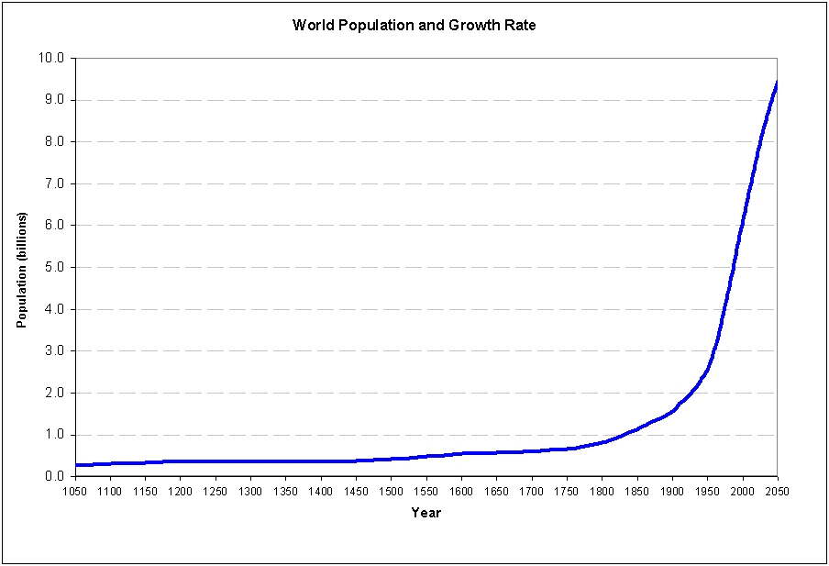
World population

Slide 3

The protein challenge
The protein challenge is mainly reflected in the way we produce and consume proteins in the 21st century, which is causing significant negative environmental impacts.
With the future challenge of feeding over nine billion people in 2050, a huge increase in protein consumption is expected.
This sharp increase in protein demand in the coming decades will require enormous amount of natural resources which are already under great pressure from e.g. the food and feed industry, climate changes and bio-fuel production.
The EU is not self-sufficient when it comes to protein production and a large proportion of the demand is met with imported proteins with concerns regarding food security and the general competitiveness of the EU.

Slide 4
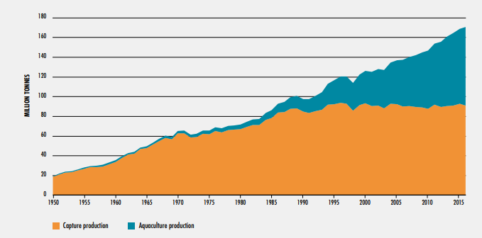
World Aquaculture and Fisheries production
Aquaculture has been the fastest growing food production sector during the last 40 years, being one of the most promising farming activities to meet near-future world food needs

Slide 5
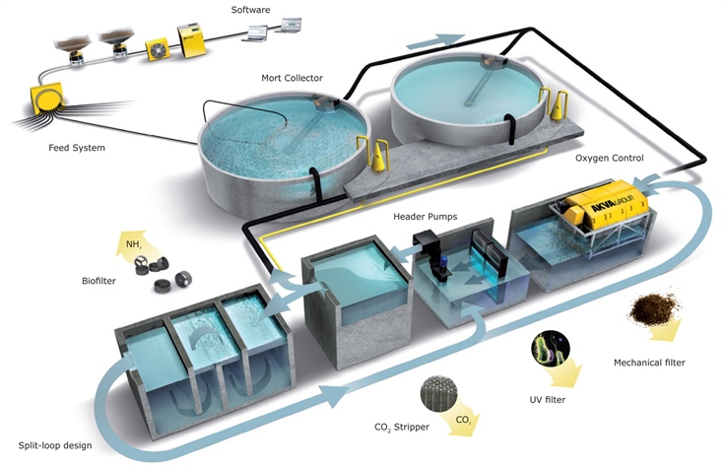
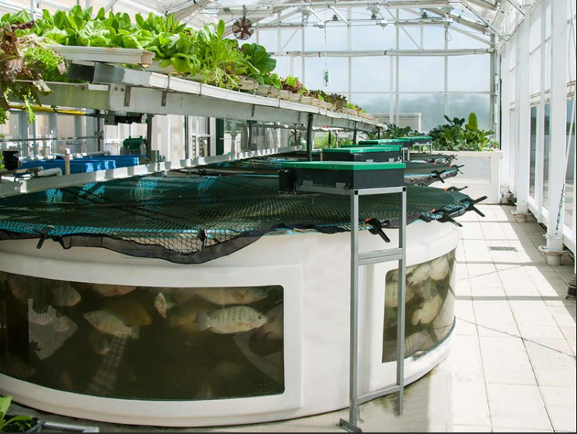
Development of efficient low impact aquaculture recirculation systems

Slide 6
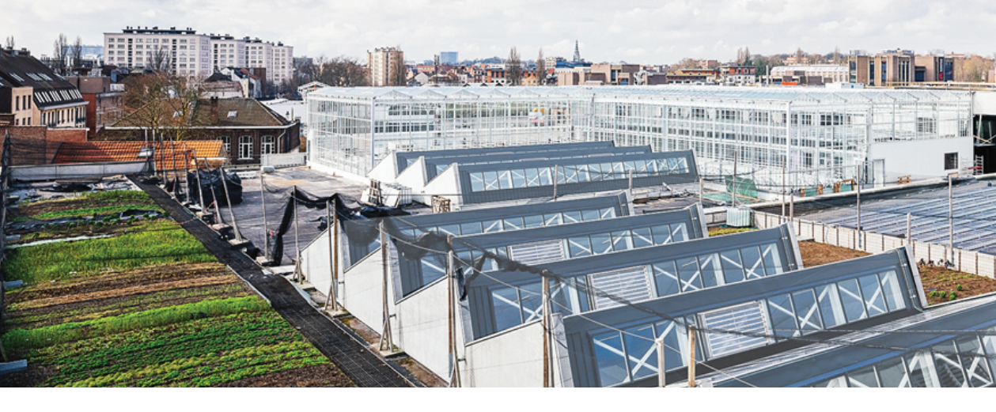
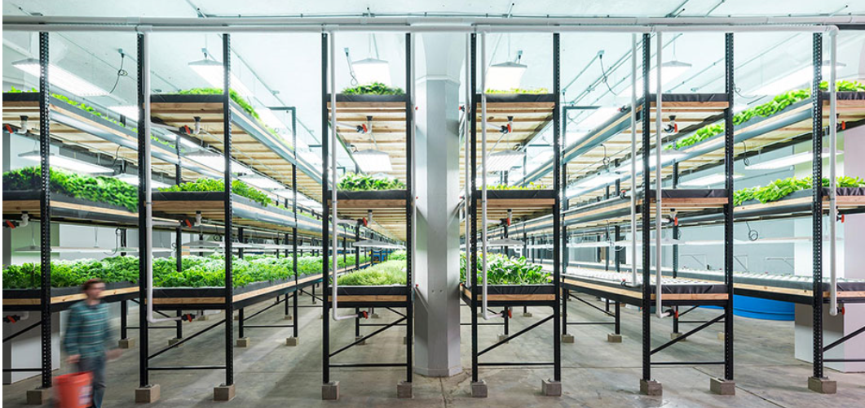
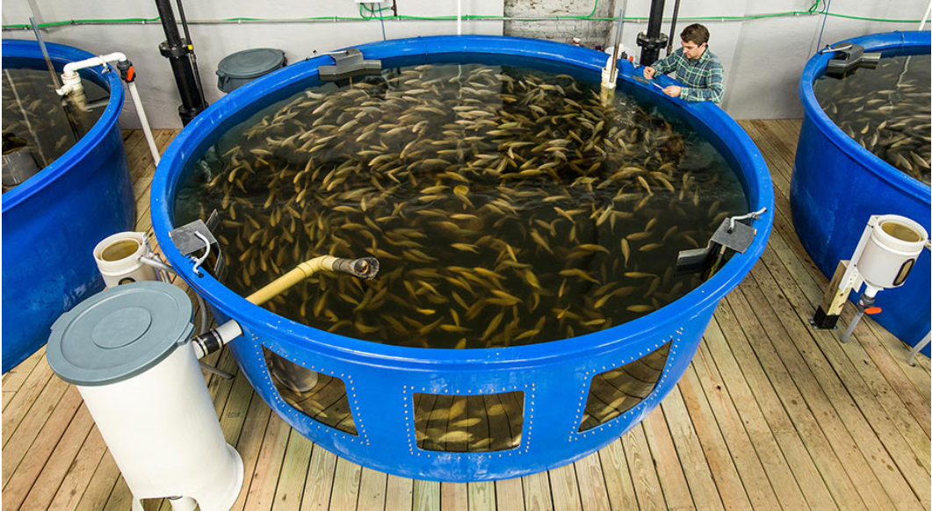
Aquaponic protein and plant production present an opportunity to reduce the environmental impact of food production, the distance that food travels, and the corresponding food, energy, and water impacts that will be incurred to feed an increasingly large urban world population.

Slide 7
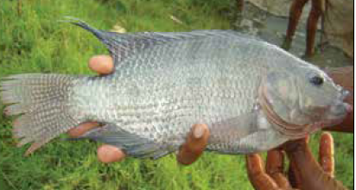
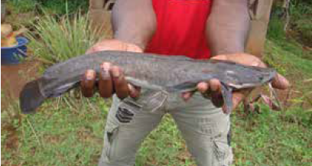
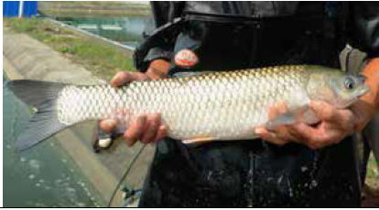
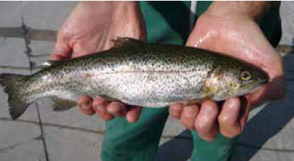
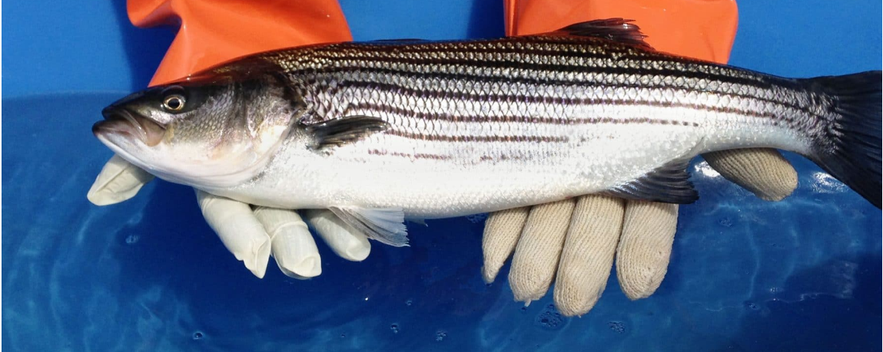
Popular fish species in Aquaponics
Criteria to select suitable species
Rearing temperature
Rearing density
Market demand and price
Juveniles availability
Feed protein demand

Slide 8
Carnivorous vs Omnivorous
High protein demand
Lower sustainability due to high animal protein requirement
High market price
Low protein demand
Higher sustainability due to low requirement of animal protein
Low market price

Slide 9
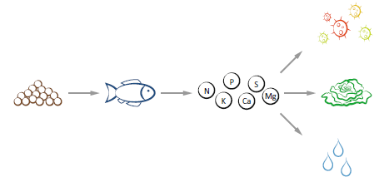
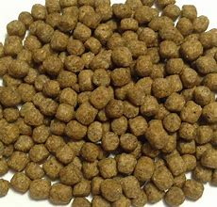
The role of fish feed in aquaponics
Tailoring aquafeeds which are specific to aquaponic systems is more challenging than conventional aquaculture feed development, as the nature of aquaponic systems requires that the aquafeeds not only supply nutrition to the cultured animals but also to the cultured plants and the microbial communities inhabiting the system

Slide 10
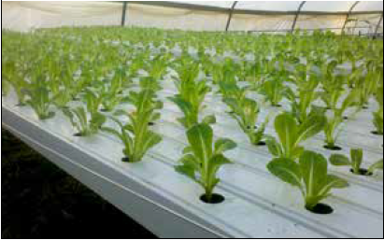
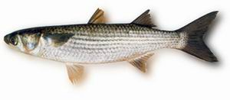
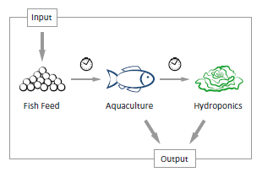
Feed for Aquaponics
Sustainable
Optimal Growth
Optimal Health
Direct mineral supplementation in aquaponic feeds
Feed additives that make nutrients more bioavailable to plant

Slide 11


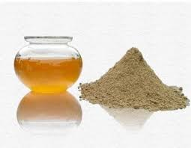
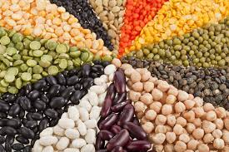
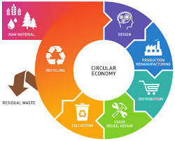
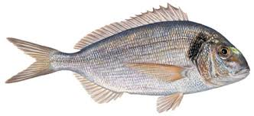
Toward sustainable feed formulations
2000
2050
Fish meal/marine based diet
Circular feed
Bacteria, yeast, insect, algae
Plant based diet

Slide 12
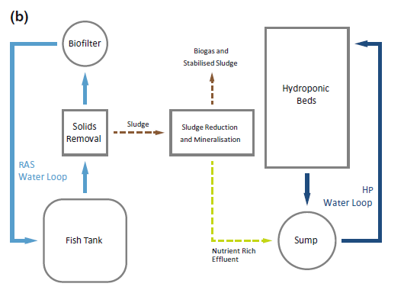
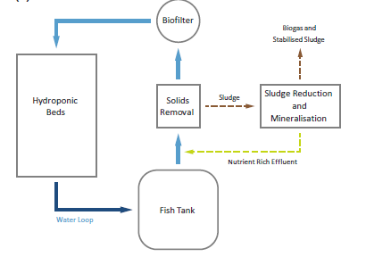
Coupled vs Decoupled Aquaponics

Slide 13
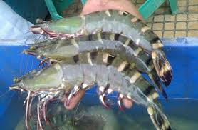
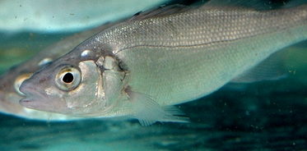
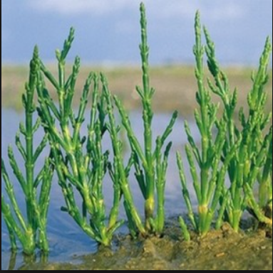
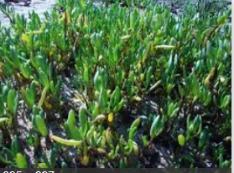
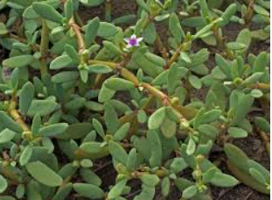
Haloponics
There is an increased interest to move towards alternative water sources (brackish to highly saline water as well as seawater) and the use of euryhaline or saltwater fish, halophytic plants, seaweed and low salt-tolerant glycophytes

Slide 14
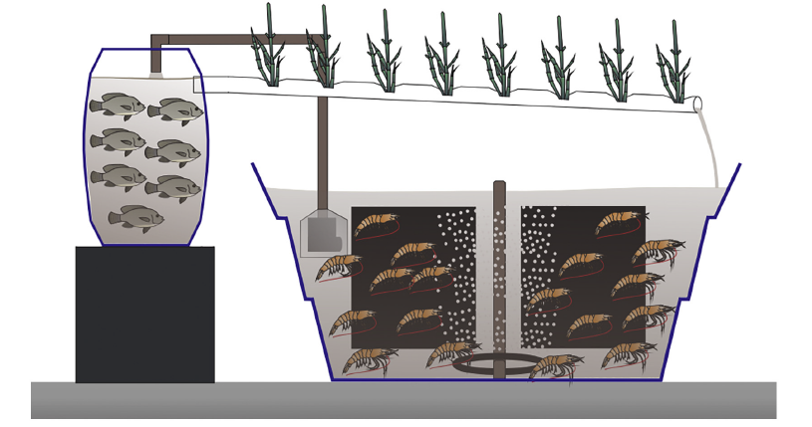
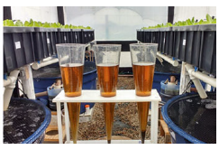
Biofloc Technology (BFT) Applied for Aquaponics
Biofloc technology (BFT) is considered the new ‘blue revolution’ in aquaculture since nutrients can be continuously recycled and reused in the culture medium, benefited by the in situ microorganism production and by the minimum or zero water exchange
Poli et al. 2019 Aquaculture
The use of bioflocs in the aquaponic system may improve the productivity of plant in an integrated culture with fish or shrimp due to the higher nutrient availability provided by the higher microbial activity

Slide 15

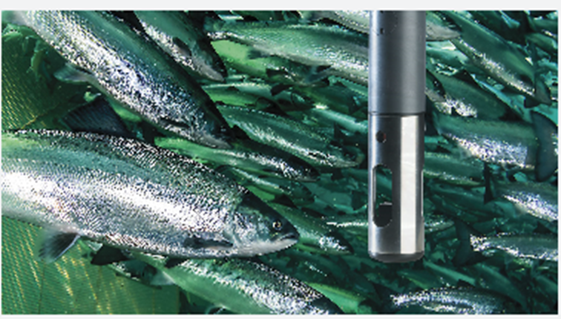
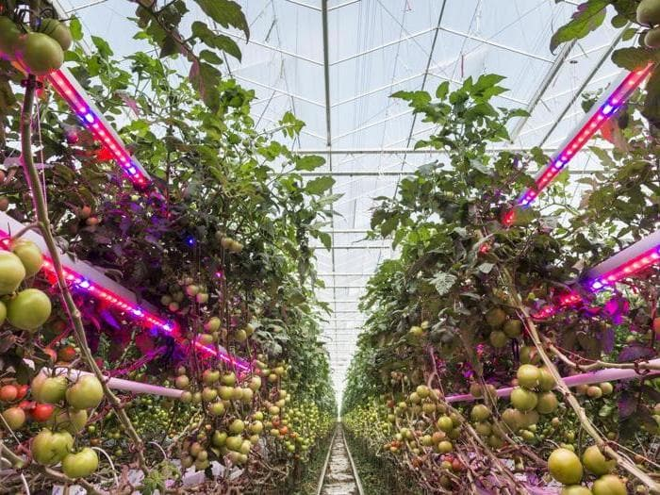

Enviromental and feeding control
Hi TECH GREEN HOUSE

Slide 16
Luca Parma
Department of Veterinary Medical Sciences
Luca.parma@unibo.it

